Slide 1
Fluvial Geomorphology: Sinuosity
Zach HIlgendorf

Slide 2
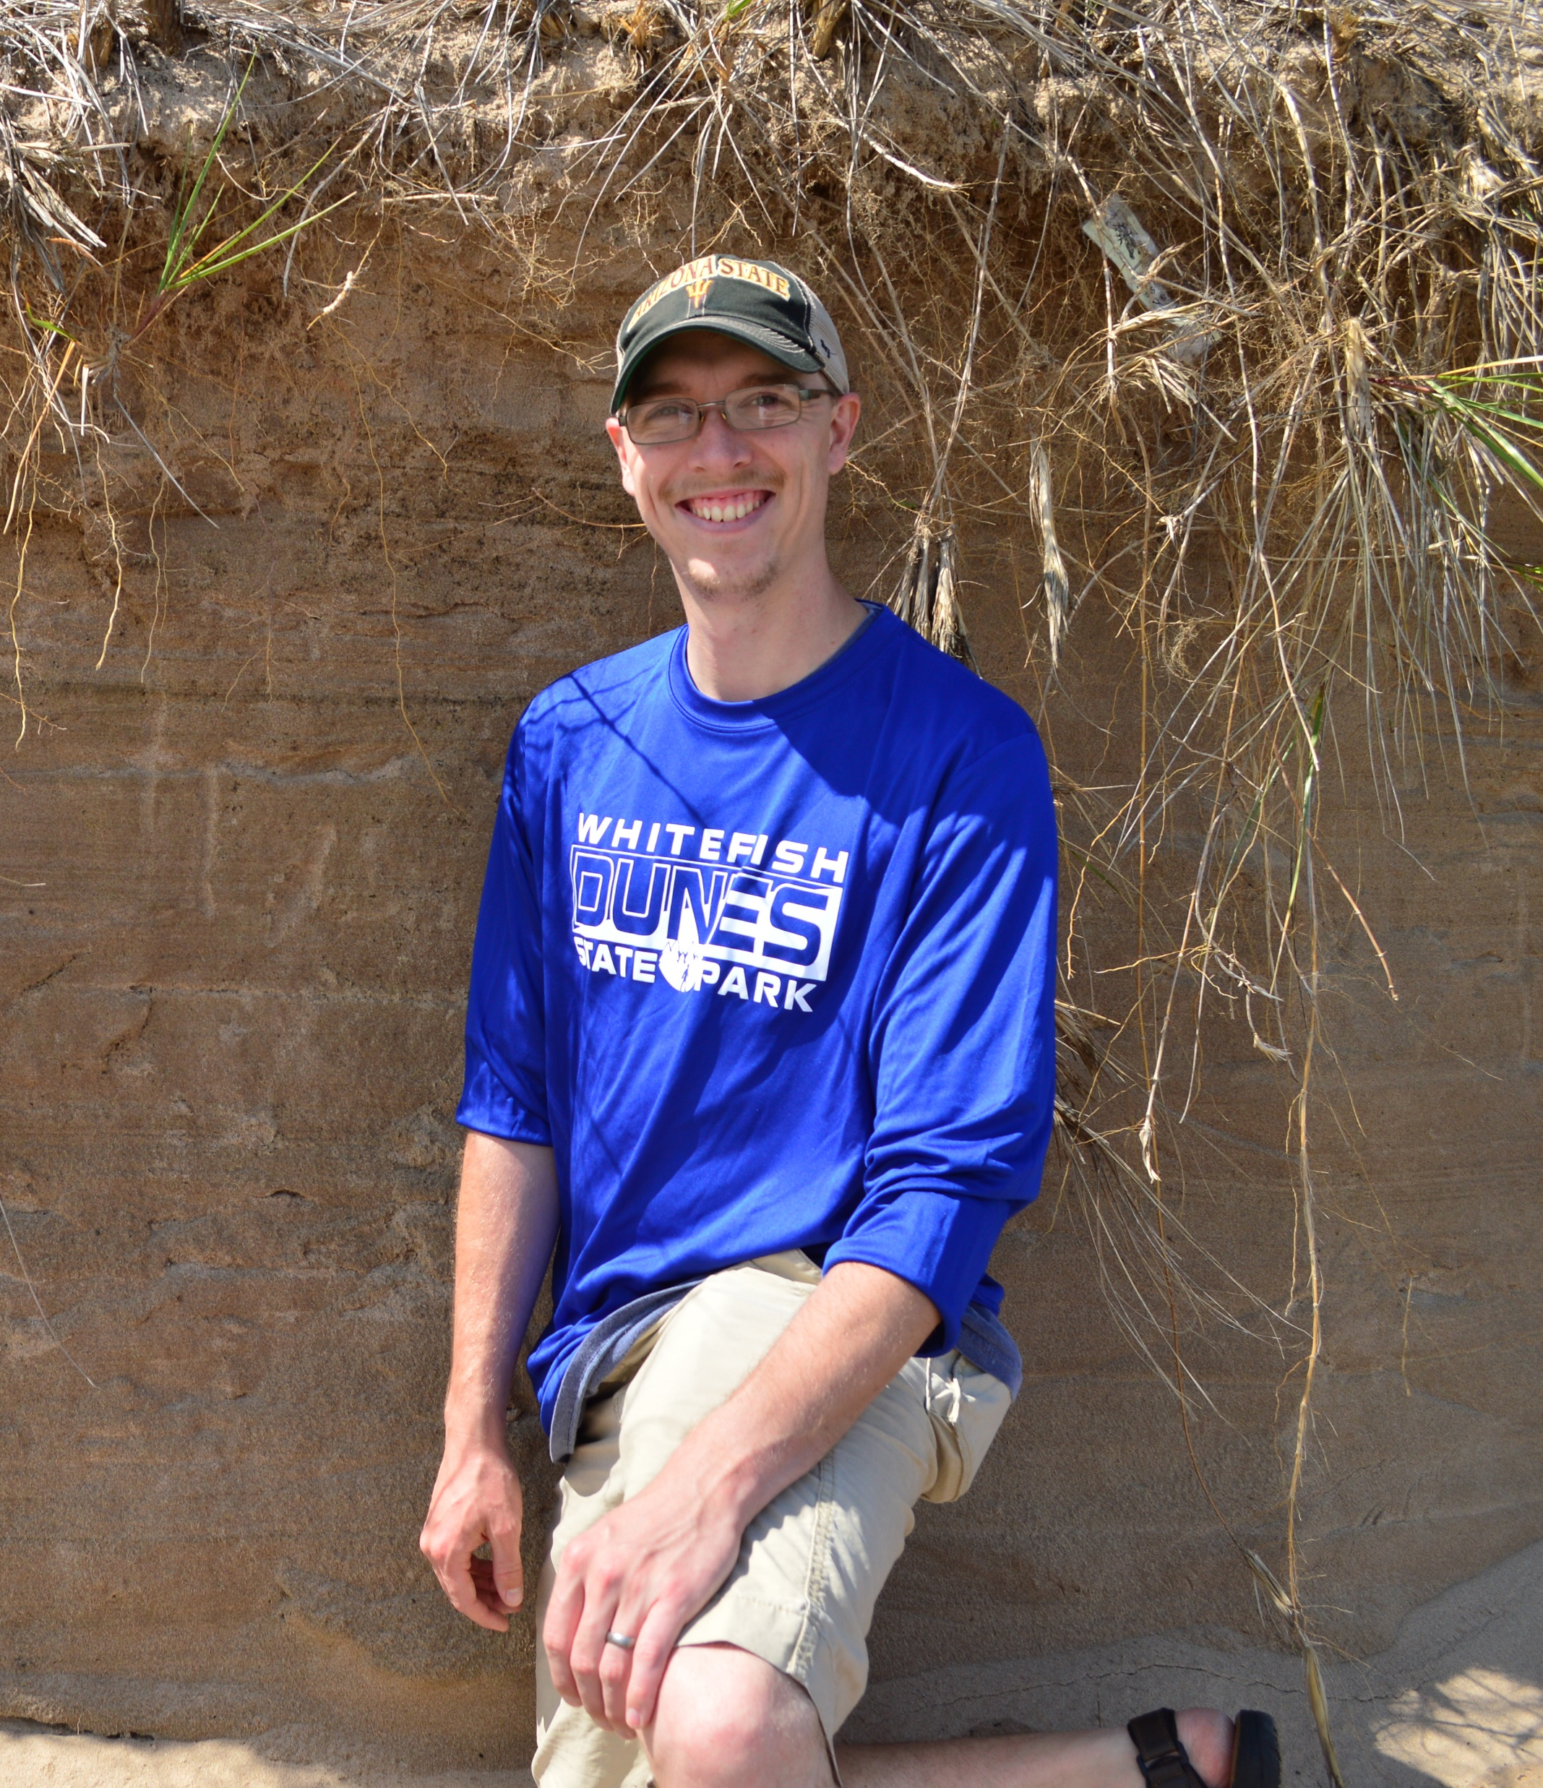
Objectives
Understand What Sinuosity Is and What it Tells Us
Understand How to Calculate Sinuosity
The geo-nerd currently talking…

Slide 3
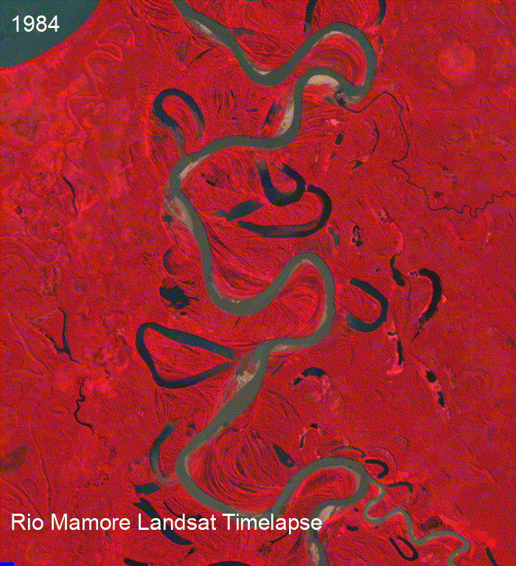

What is Sinuosity?
A ratio that tells us how “curvy” a river is
$Sinuosity= \frac{Channel Length}{Valley Length}$

Slide 4
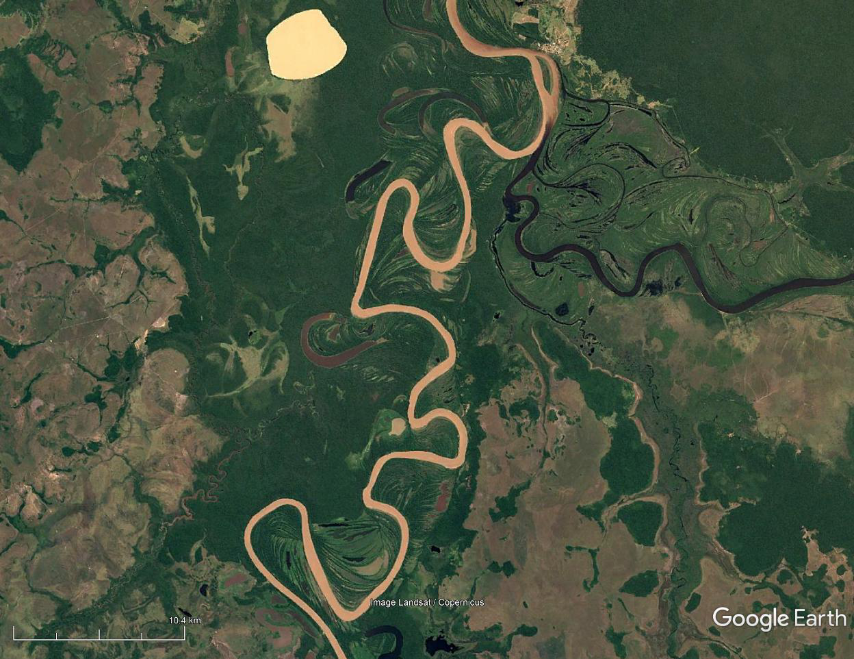
What is Sinuosity?
A ratio that tells us how “curvy” a river is
$Sinuosity= \frac{Channel Length}{Valley Length}$

Slide 5
What is Sinuosity?
A ratio that tells us how “curvy” a river is
$Sinuosity= \frac{Channel Length}{Valley Length}$

Slide 6
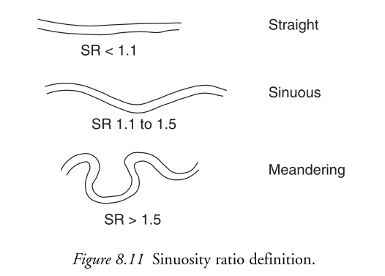

What is Sinuosity?
A ratio that tells us how “curvy” a river is
$Sinuosity= \frac{Channel Length}{Valley Length}$
Higher values = Higher sinuosity
Anabranching, Braided, and Straight Rivers = Lower Sinuosity
Charlton (2008): Fundamentals of Fluvial Geomorphology

Slide 7
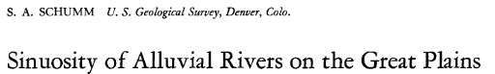
What is Sinuosity?
A ratio that tells us how “curvy” a river is
$Sinuosity= \frac{Channel Length}{Valley Length}$
Higher values = Higher sinuosity
Anabranching, Braided, and Straight Rivers = Lower Sinuosity

Slide 8
Example Calculations

Slide 9
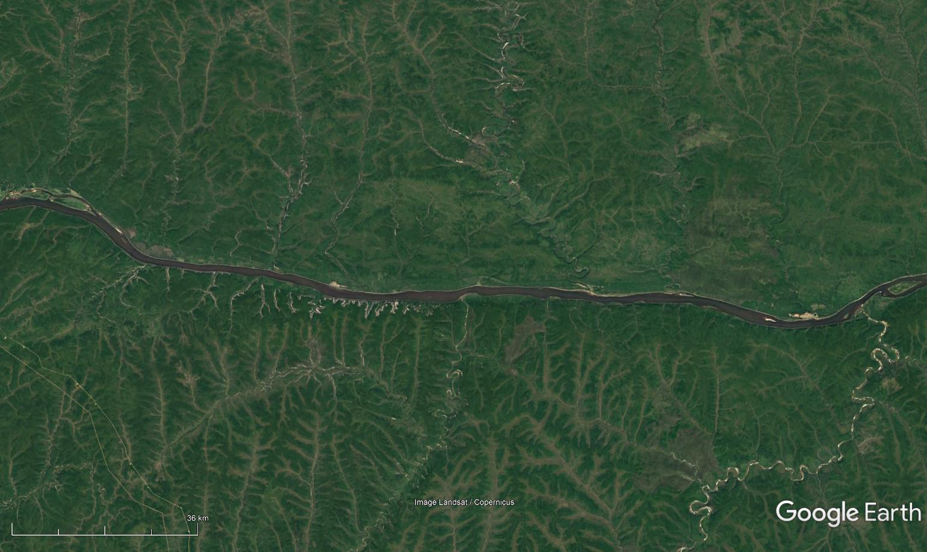
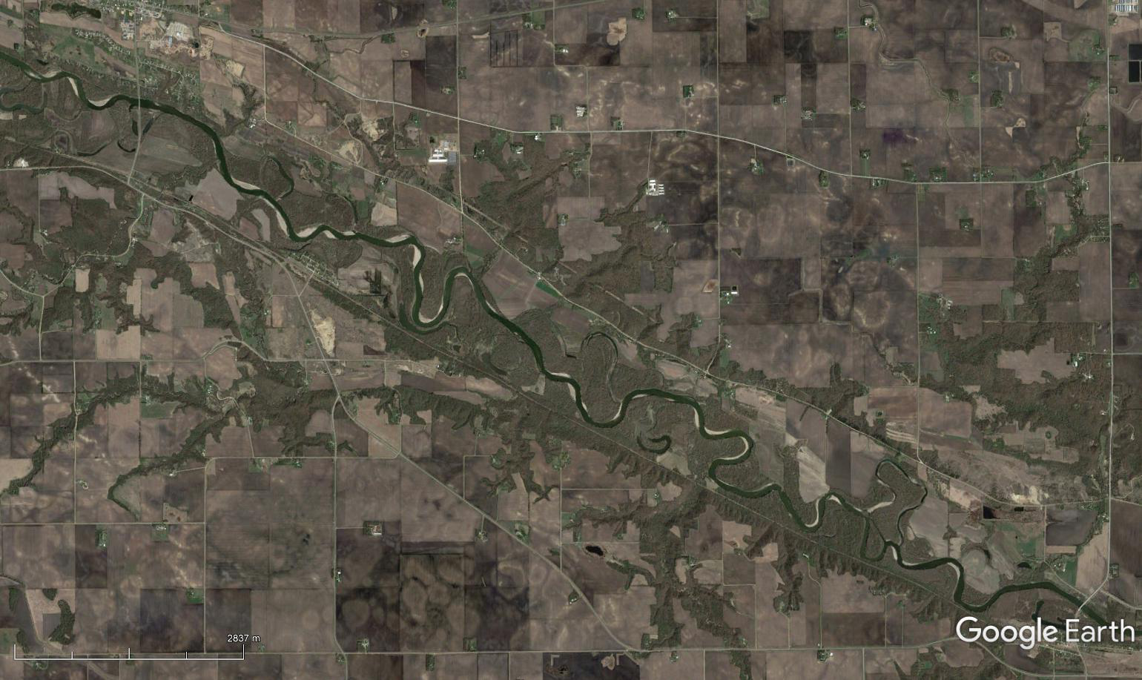
What is Sinuosity?
Sinuosity = Channel Length / Valley Length
Lena River, Russia
Minnesota River, Minnesota, USA

Slide 10
What is Sinuosity?
Sinuosity = Channel Length / Valley Length
Lena River, Russia
Minnesota River, Minnesota, USA

Slide 11
What is Sinuosity?
Sinuosity = Channel Length / Valley Length
Lena River, Russia
Minnesota River, Minnesota, USA
Valley Length: 187 km
Channel Length:
Valley Length: 12.3 km
Channel Length:

Slide 12
What is Sinuosity?
Sinuosity = Channel Length / Valley Length
Lena River, Russia
Minnesota River, Minnesota, USA
Valley Length: 187 km
Channel Length: 188 km
Valley Length: 12.3 km
Channel Length: 18.2 km

Slide 13
What is Sinuosity?
PAUSE
Sinuosity = Channel Length / Valley Length
Lena River, Russia
Minnesota River, Minnesota, USA
Valley Length: 187 km
Channel Length: 188 km
Valley Length: 12.3 km
Channel Length: 18.2 km

Slide 14
What is Sinuosity?
Sinuosity = Channel Length / Valley Length
Lena River, Russia
Minnesota River, Minnesota, USA
Low Sinuosity: 1.01
Sinuosity Ratio < 1.1 = Straight Channel
High Sinuosity: 1.48
Sinuosity Ratio near 1.1-1.5 (Sinuous) and > 1.5 (Meandering)

Slide 15
Recap
What sinuosity is.
How to calculate sinuosity.

